Slide 1

Final Presentation
CS 5500 Foundations of Software Engineering
Jainam Sheth
Devanshi Ganatra
Purvil Bambharolia
Dipen Patel

Slide 2
System Functionalities
Basic Functionalities
User Functions
Message Functions
Group Functions
Government Functions
Completed all 88 issues
45/45 must have requirements were finished.
7/15 good to have requirements were finished.

Slide 3
Achievements
Goal : Build a Java supported web socket backend for the chat system Sprint Goals:
S1 : Integrate prattle into build system.
S2 : Integrate Database with the system and implement features for User to User messages.
S3: Feature of messaging in a Group and other Message features like Media upload and message forwarding.
S4: Government Functions and features such as Polls and Threads in Group messaging.

Slide 4
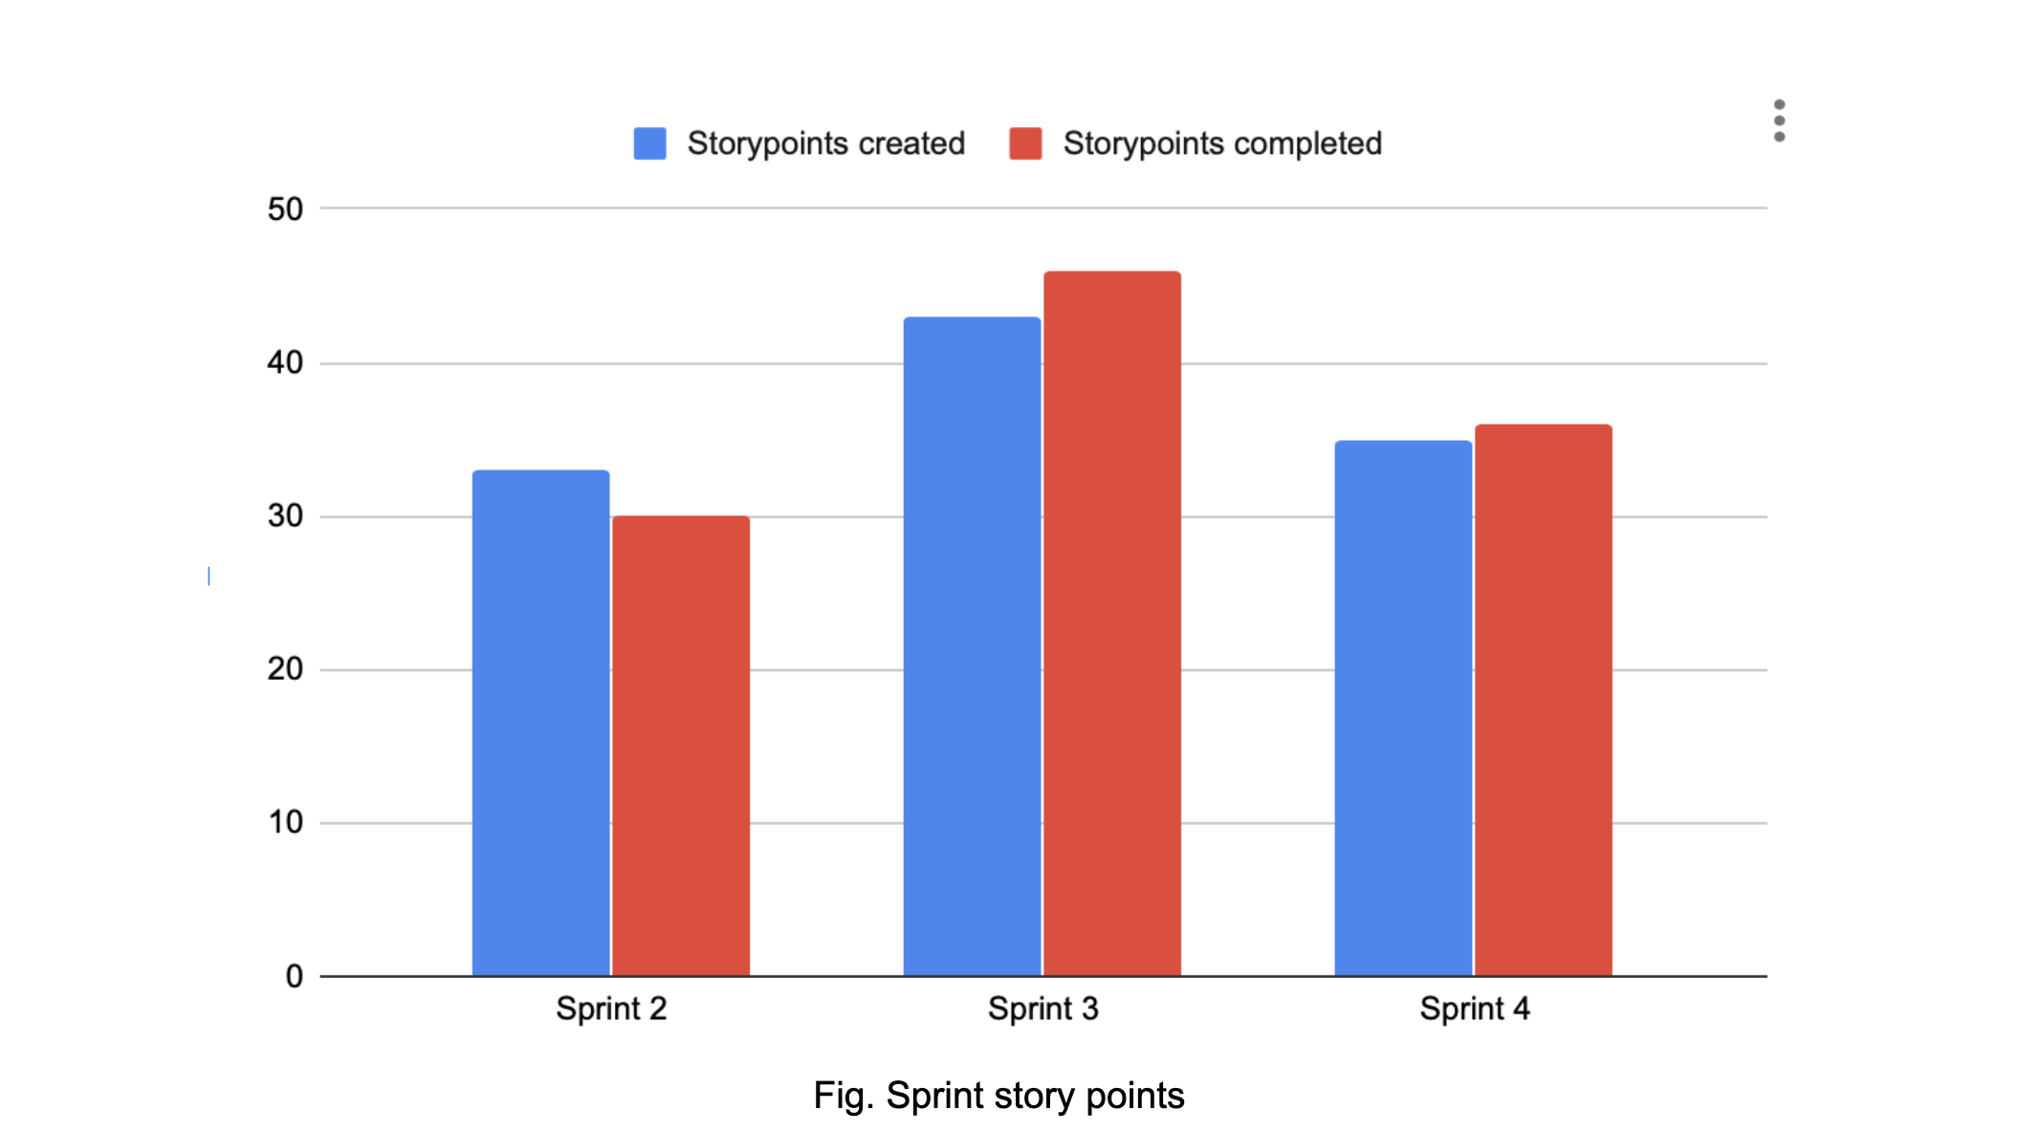

Slide 5
Usefulness to Client
Provides the client to have secure messaging within the team or the company.
Provides the platform to share media files, important documents using suitable encryption in place.
Provides the ability to gather user statistics using polls feature.
Provides platform to create private groups/channel for private messaging within the team.
Provides the ability for a user to authenticate using 3rd party services such as LinkedIn, Facebook, Google etc.
Offers different levels of tier services to the client.

Slide 6
Process & Teamwork
We had daily stand-up meetings for about 15-20 minutes to resolve any conflicts and keep a check on the progress. The agenda for the Sprint meeting was as below:
Identify requirements
Decide what needs to be done in order to accomplish a requirement and accordingly take up the following task
Distribution of work
Each team member was assigned issues to work upon keeping in the equal distribution of workload.
Help teammates
If a teammate is stuck on a task, then efforts were made to solve it and help that teammate.

Slide 7
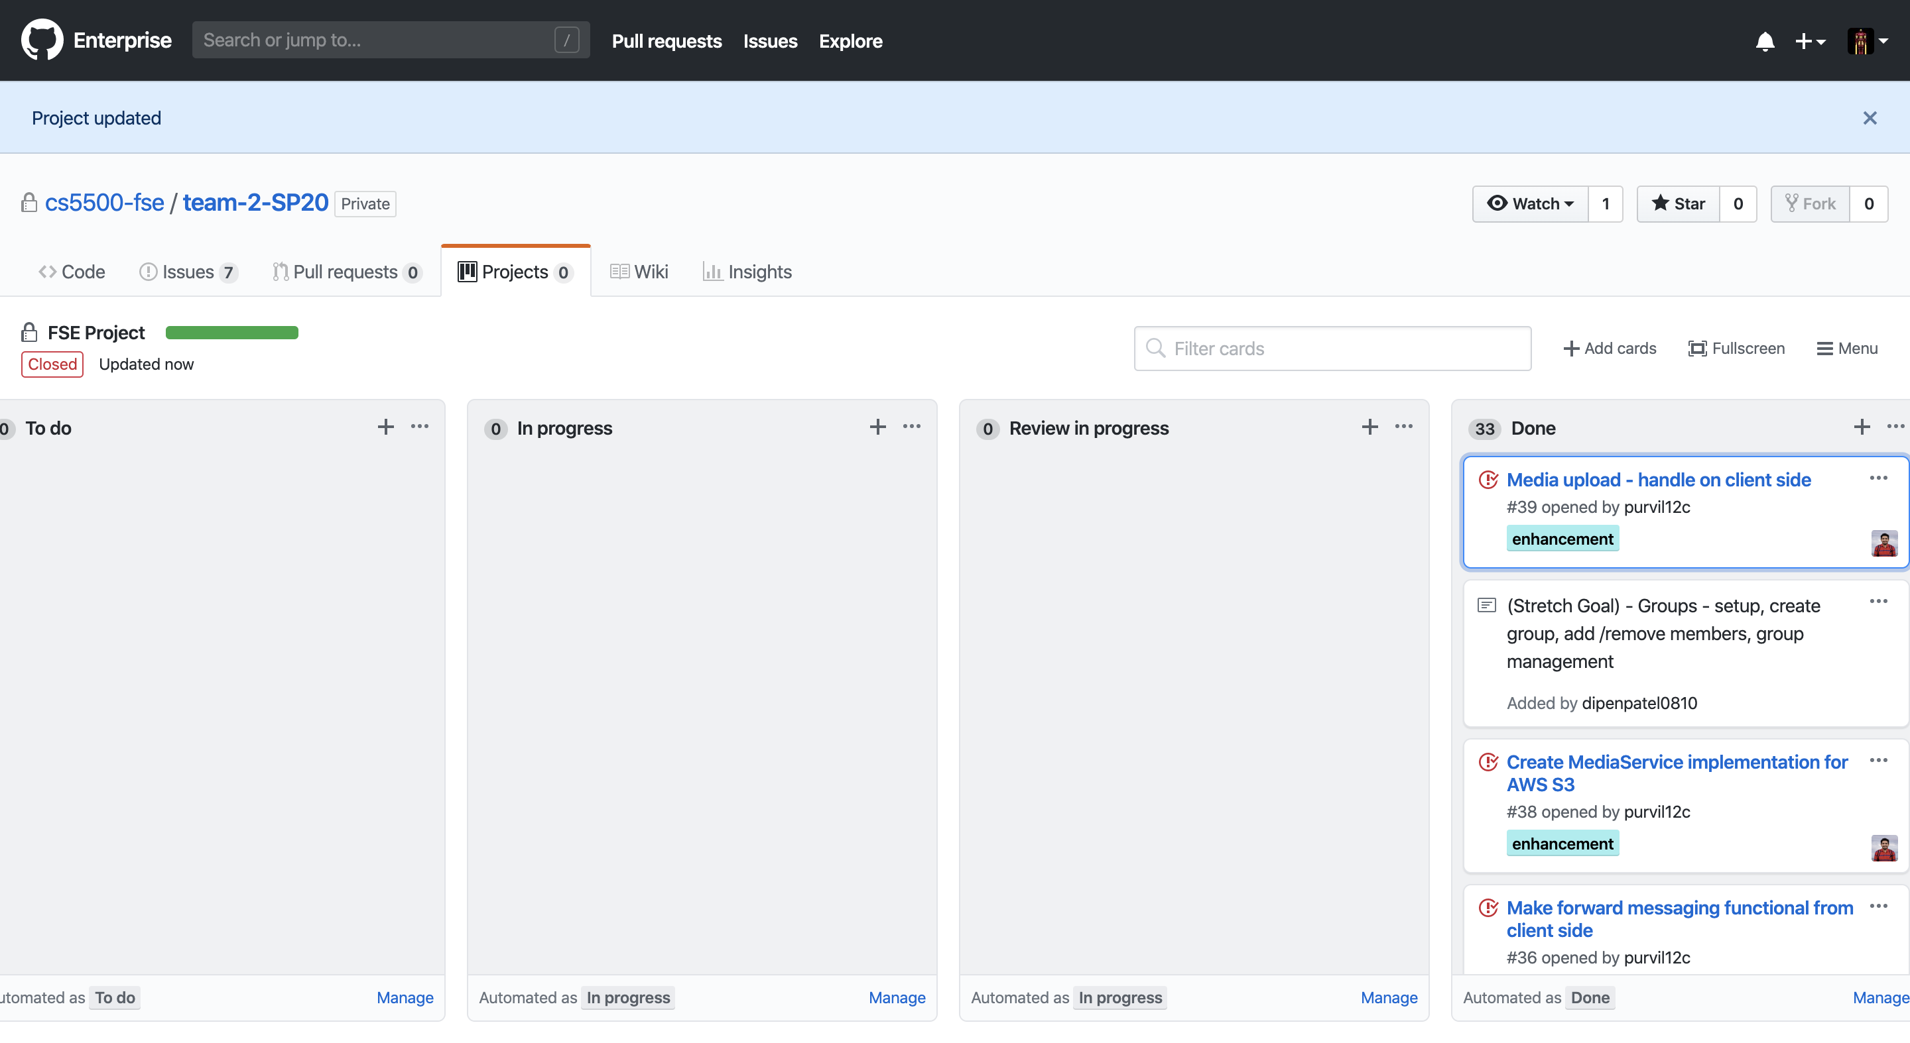
Development Process
We used Github project for managing our sprints and track our development process

Slide 8
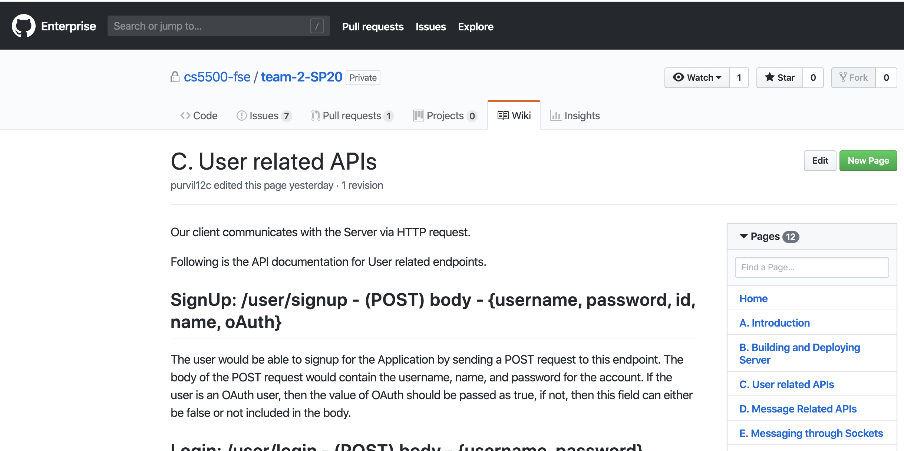
Wiki page was made documenting all the API

Slide 9
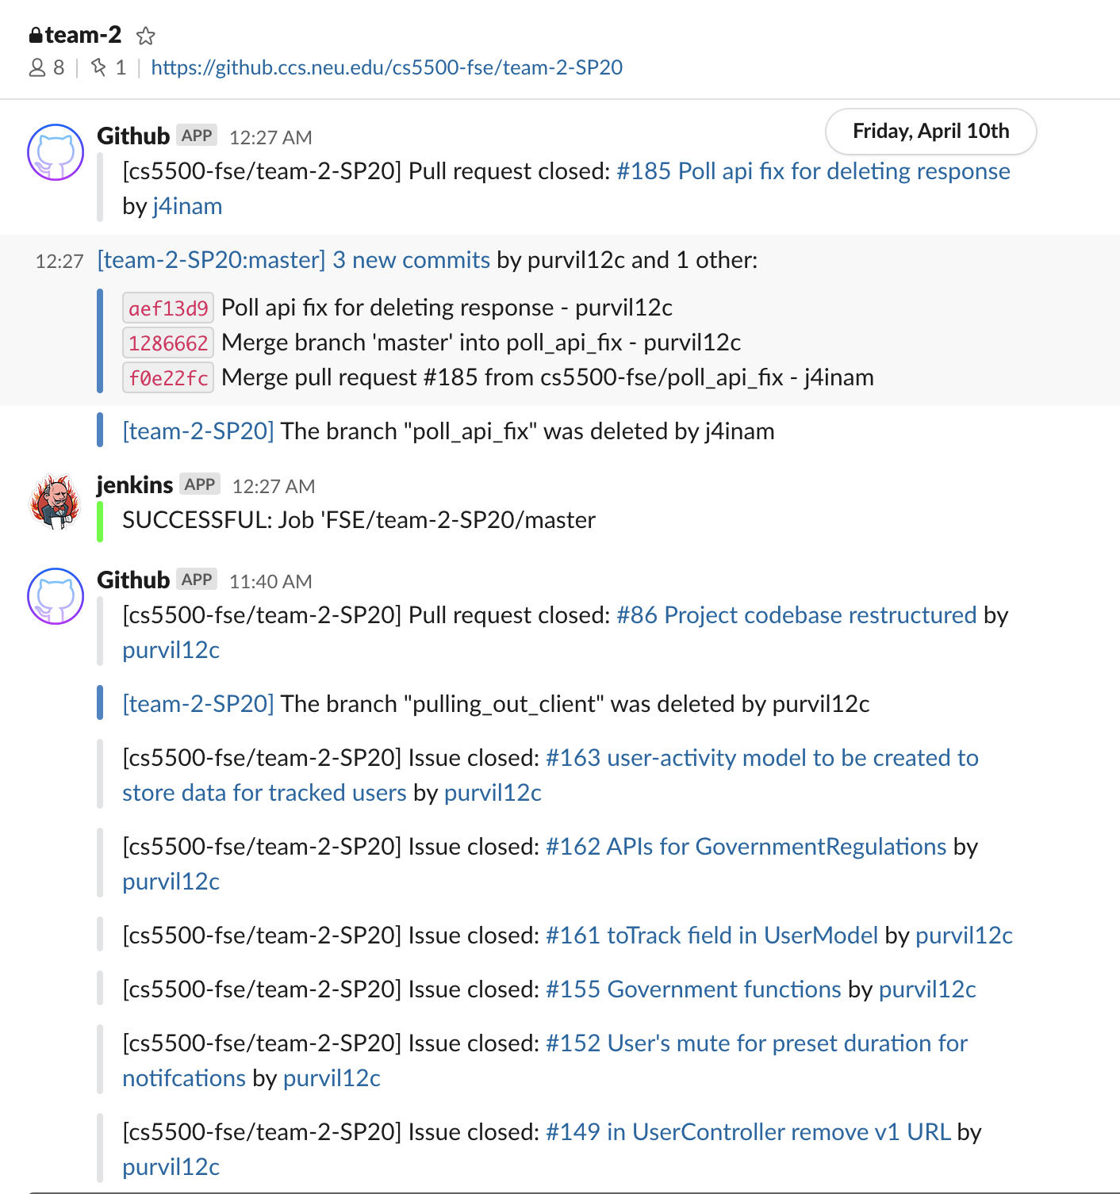
Integrated Github and Jenkins in Slack so that the team would be notified for all the activities.

Slide 10
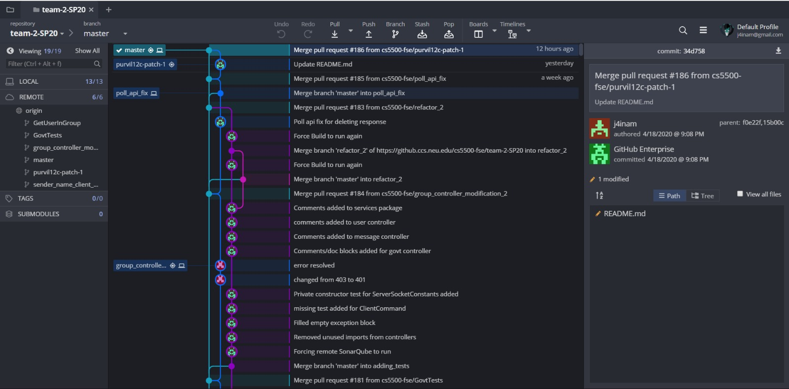
Implemented Git Workflow

Slide 11
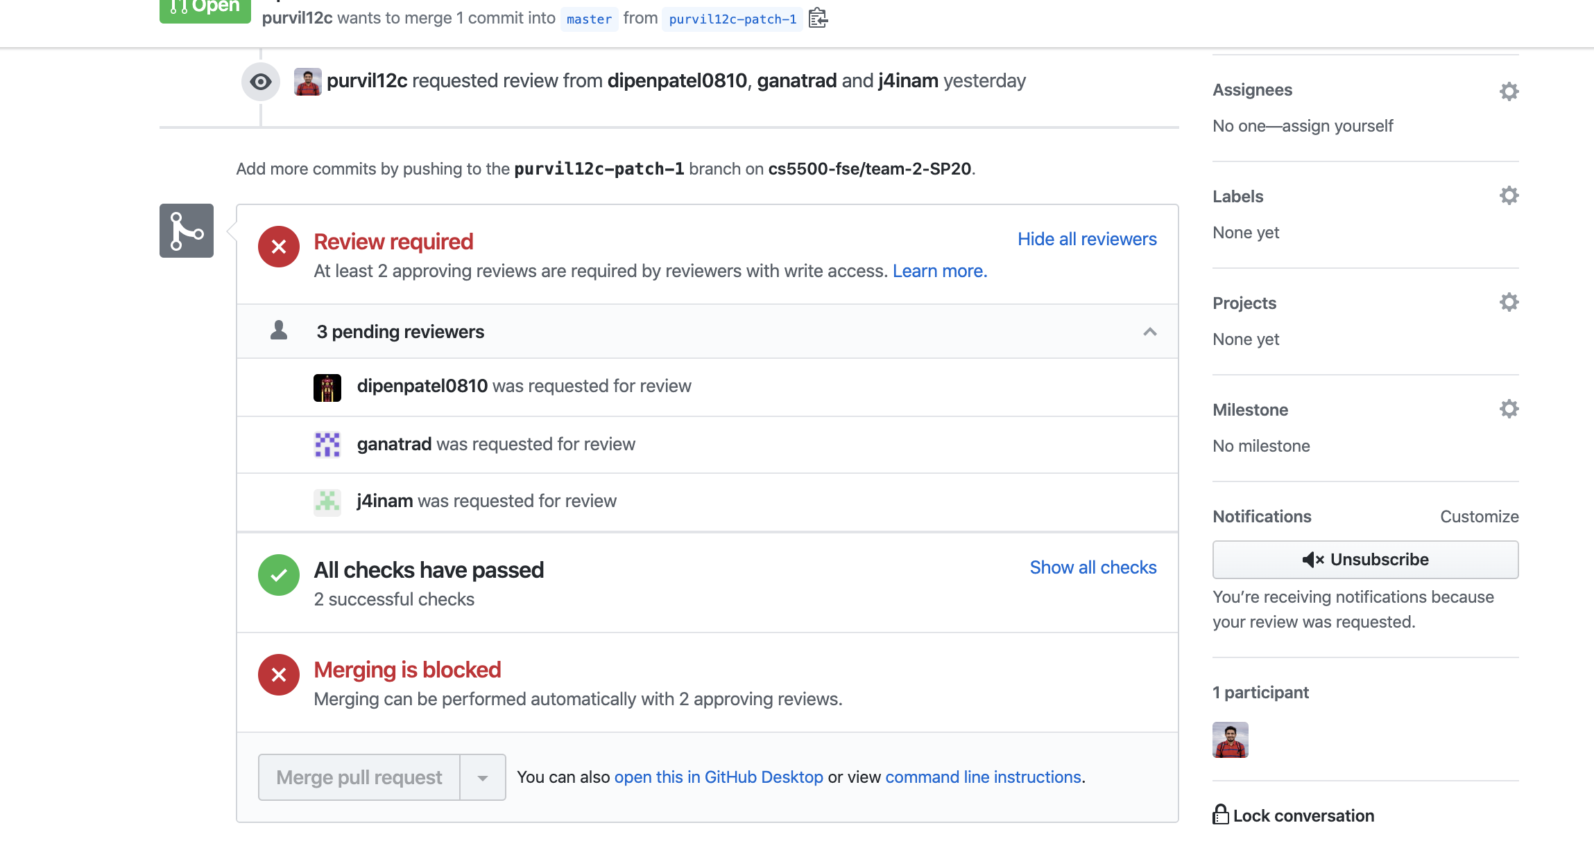
Teammates must review the changes before merging into master

Slide 12

Job Quality
Database and Services
Abstracted in a such a way that a single interface can be extended for any model service.
Singleton pattern used to prevent creation of multiple instances.
Model
Builder Pattern used to avoid multiple constructors
View
Observer pattern for client state changes.
Command pattern for execution of different commands.

Slide 13
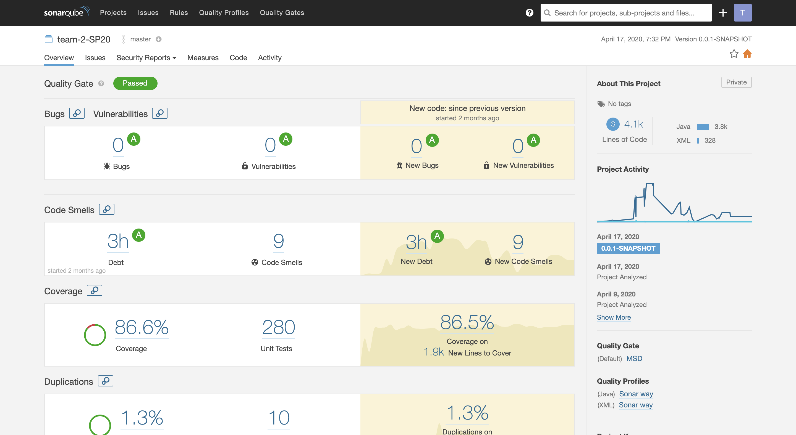
Code Quality
Code/condition coverage
Duplications
Code smells
Testing Mindset
Feature driven testing
Unit testing with the help of Mockito
Integration tests

Slide 14
Next Steps/Improvements
Areas of Improvement
Technical Improvements :
Switching to microservice architecture for higher scalability
Switching to GraphQL based backend to avoid explosion of controller APIs.
Time Management :
Avoid last minute tensions across the team

Slide 15
Future Goals
End to end message translation for better user experience.
Add time to live for Messages.
Delete messages for everyone feature.
Add ability for Parental Control.
Tracking viewers of the message.

Slide 16
System handover
System has been intensively tested and has achieved over 85% of code coverage.
System has been built using recognized design pattern like Builder pattern, Observer pattern etc.
Best coding practices have been implemented to keep the code modular and reusable. We have followed SonarQube standards to achieve minimal code smells, reduced vulnerabilities etc.
APIs are extensively documented.

Slide 17
Thank you!

